Slide 1
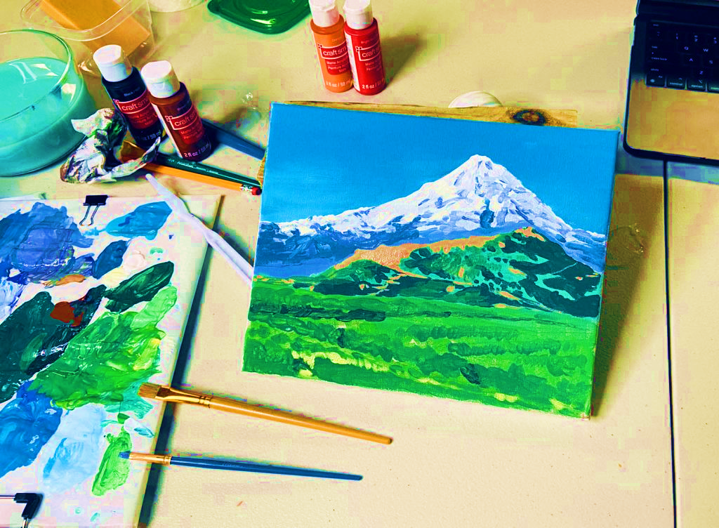
Art project
Landscape Painting

Slide 2
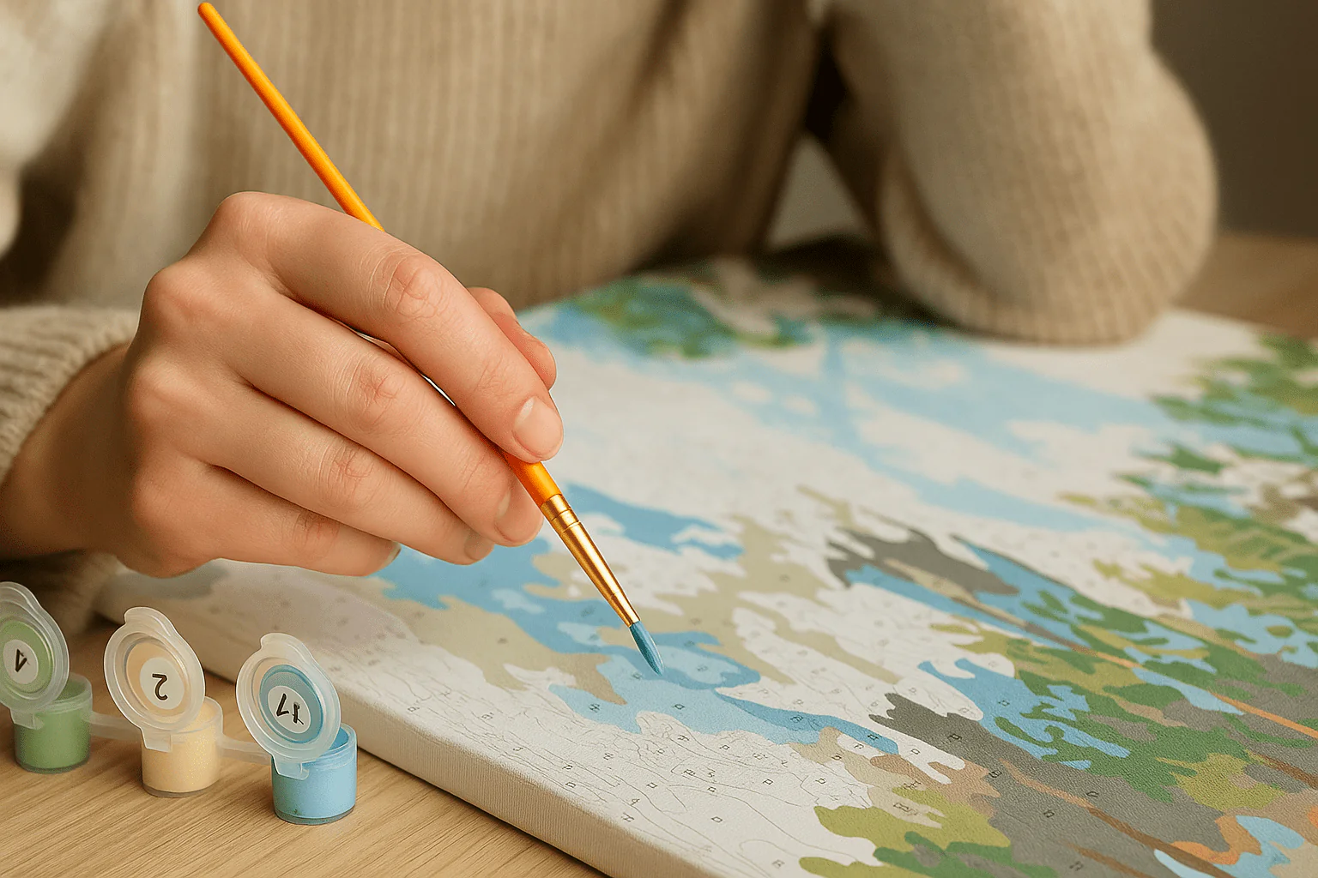
outline
1. which topic
2. task
3. time and grade
4. where I did the project
5. alone or together
6. materials, sources
7. working process
8. problems
9. aims/goals
10. reflection

Slide 3
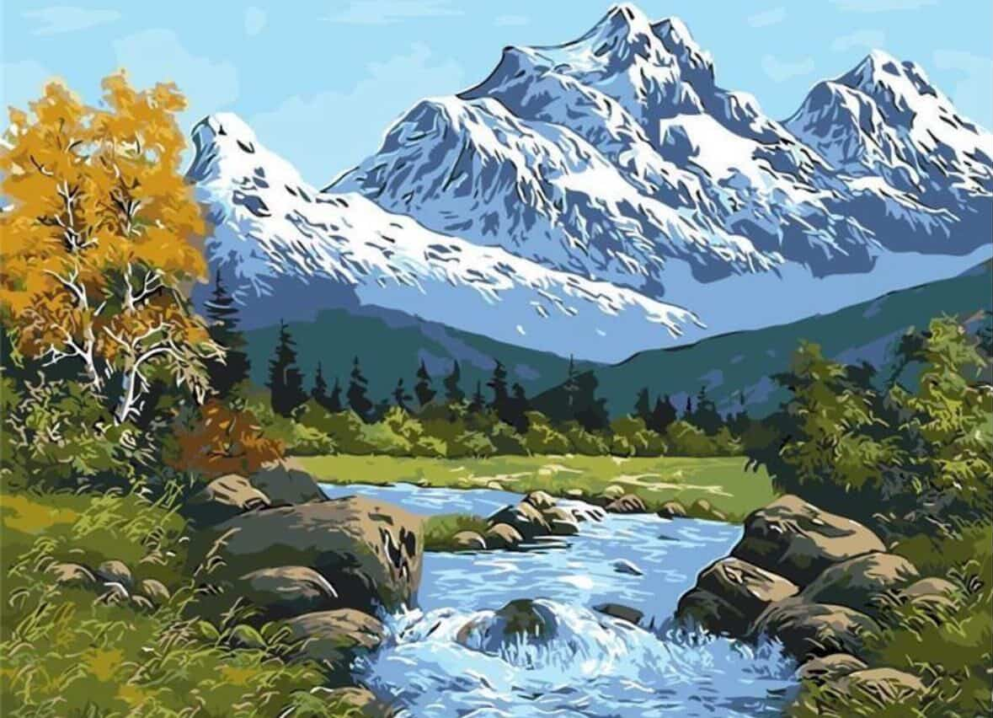
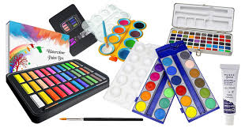
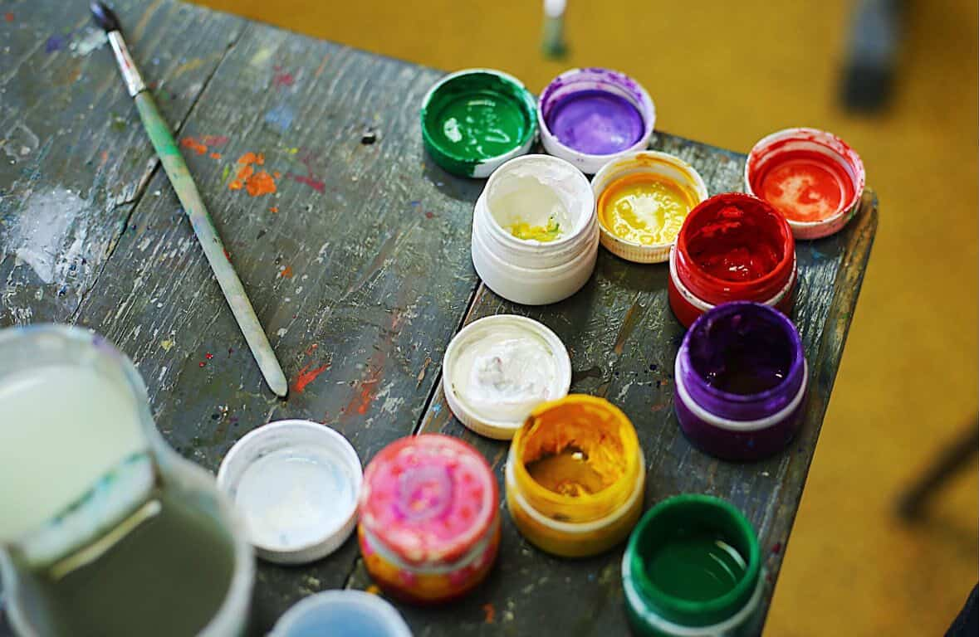
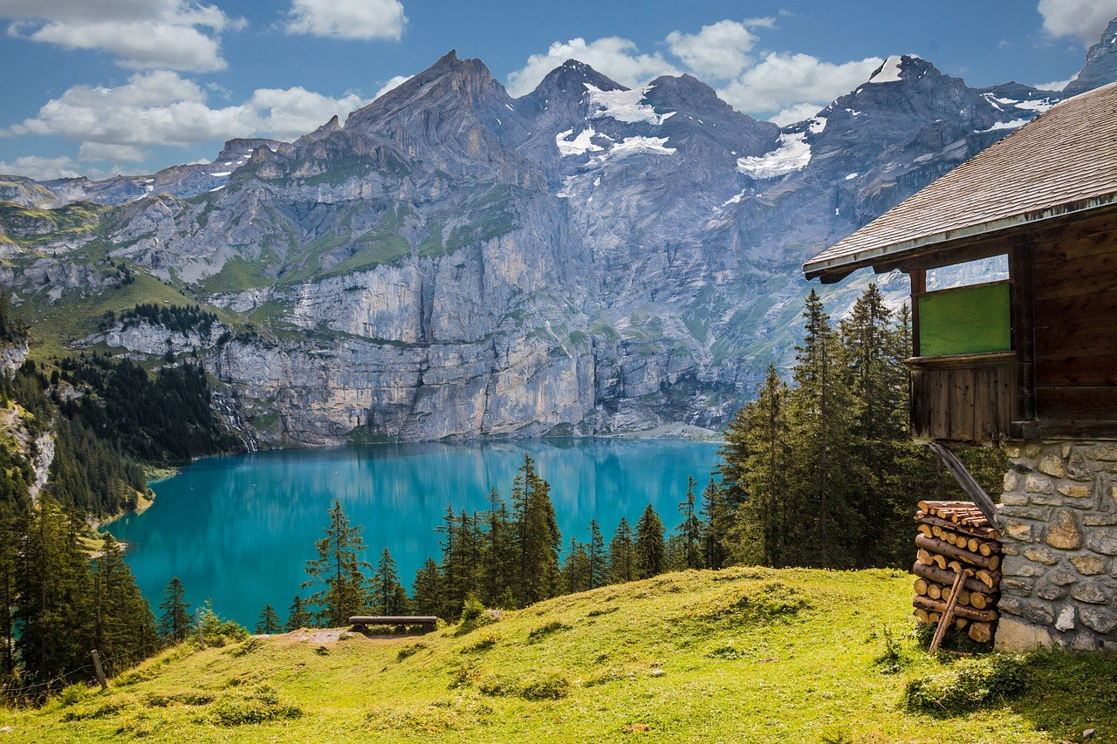
1.Which topic

Slide 4
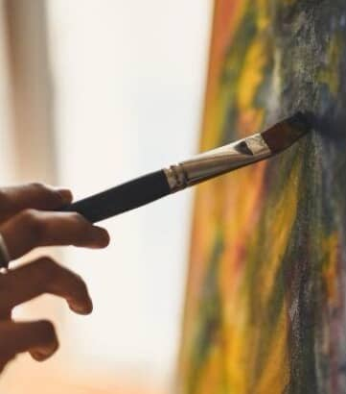
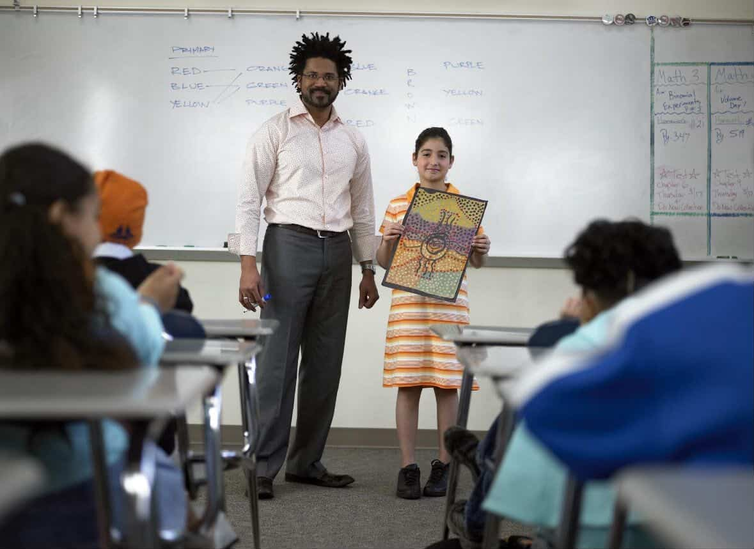
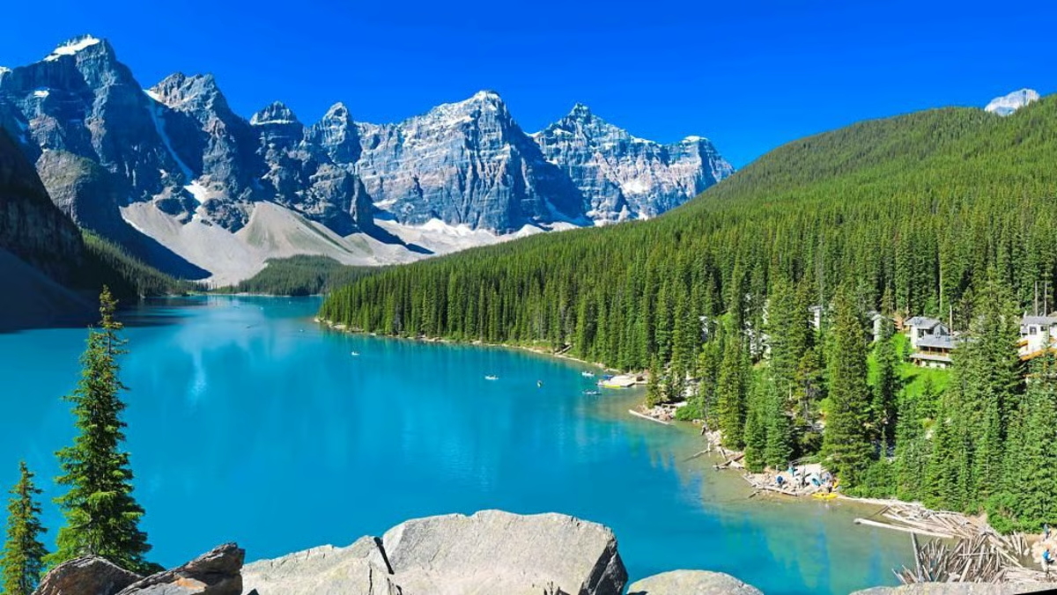
2. task

Slide 5


3.Time and grade

Slide 6

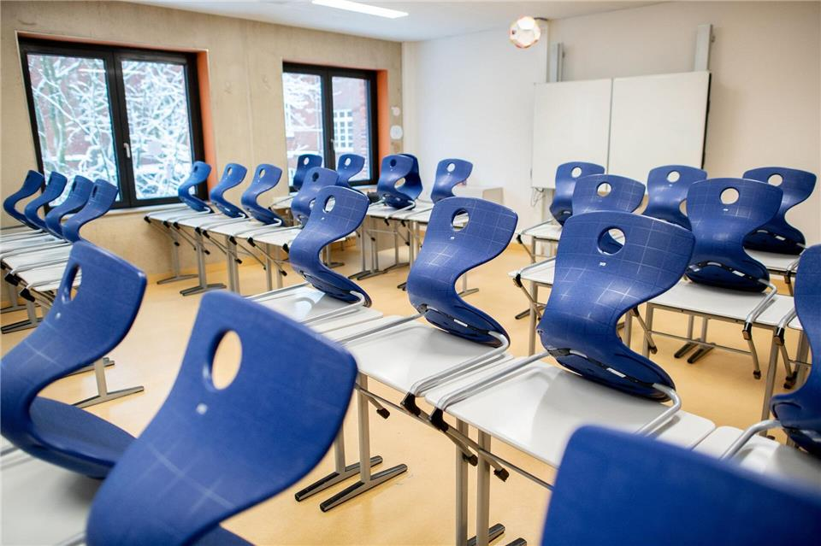
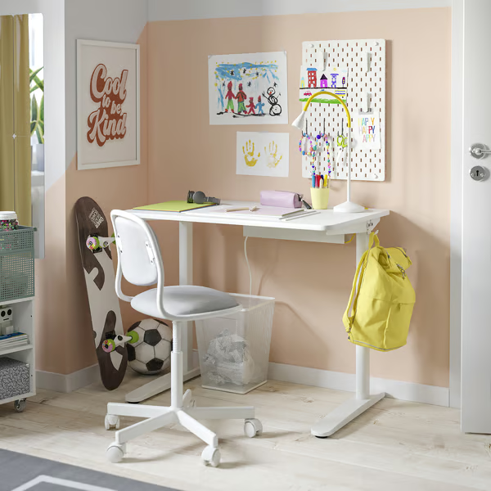
4. where I did the project

Slide 7



5. alone or together

Slide 8
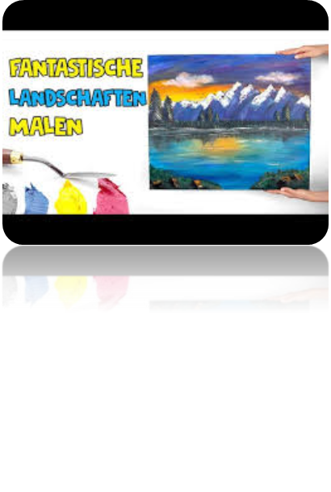

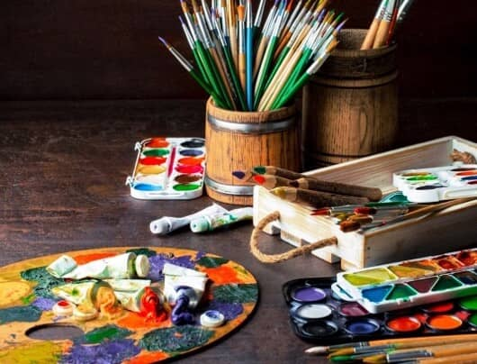

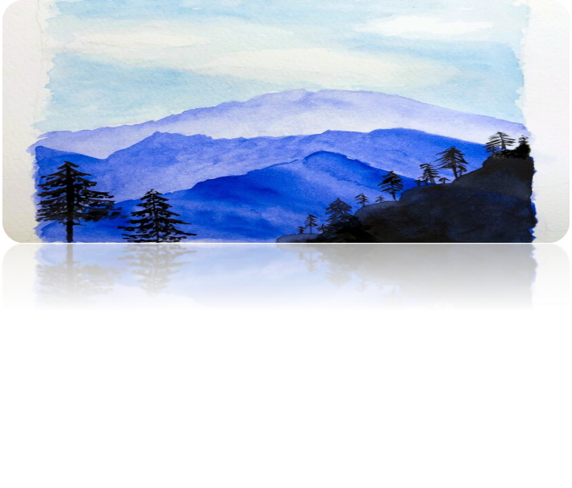
6. materials

Slide 9
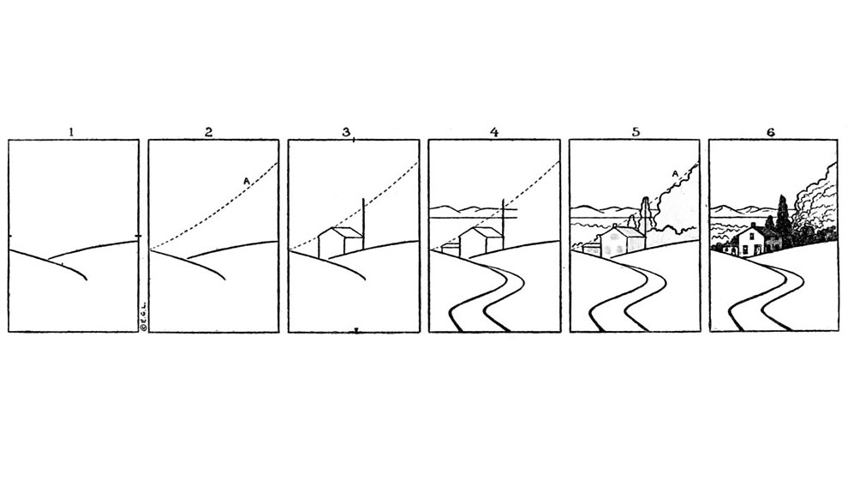

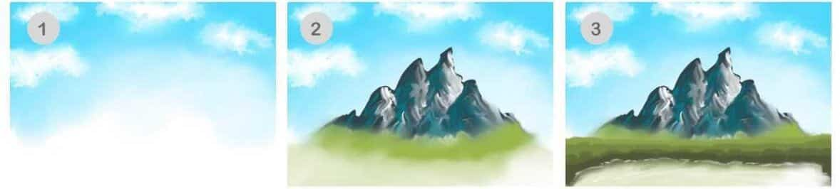
7. working process

Slide 10
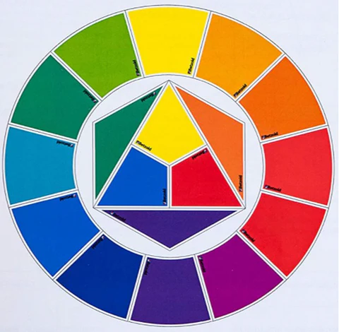
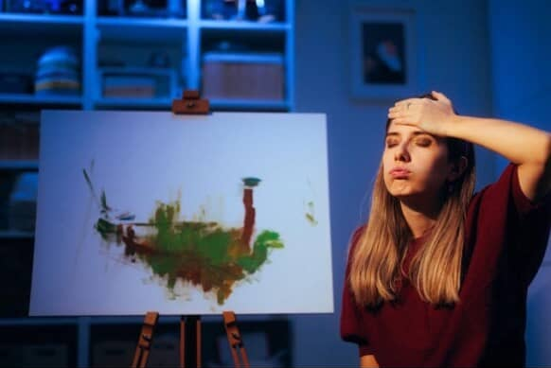
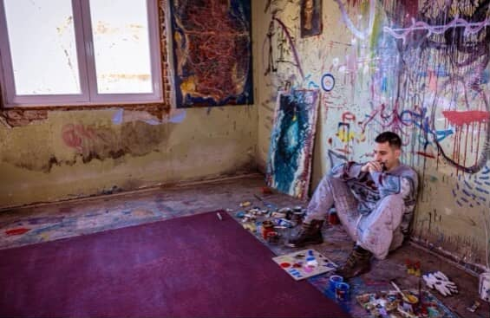
8. problems

Slide 11

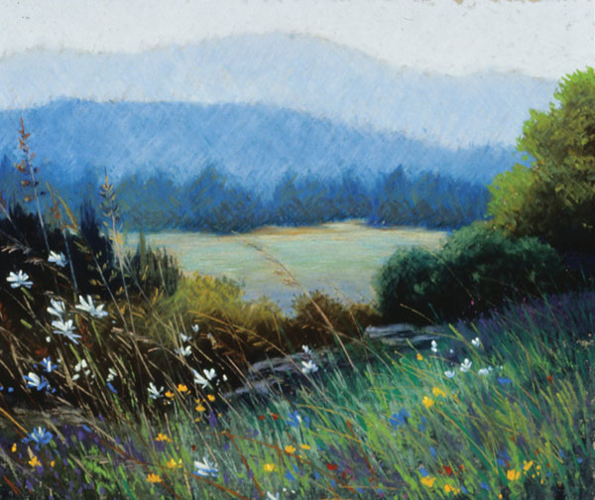
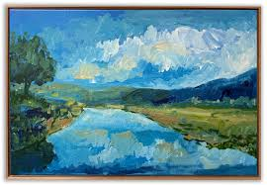
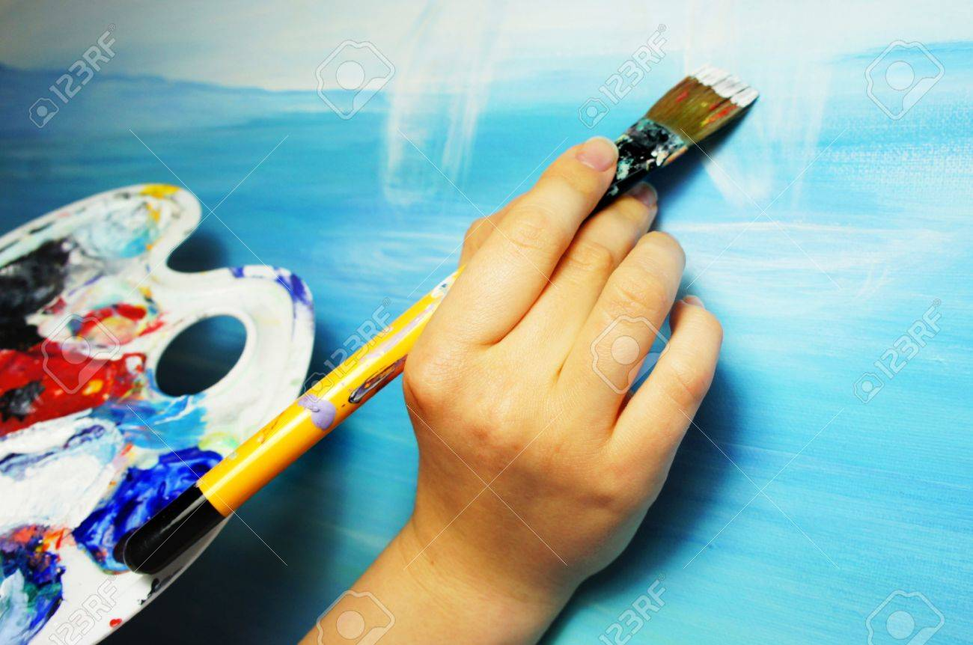
9. aims/goals

Slide 12

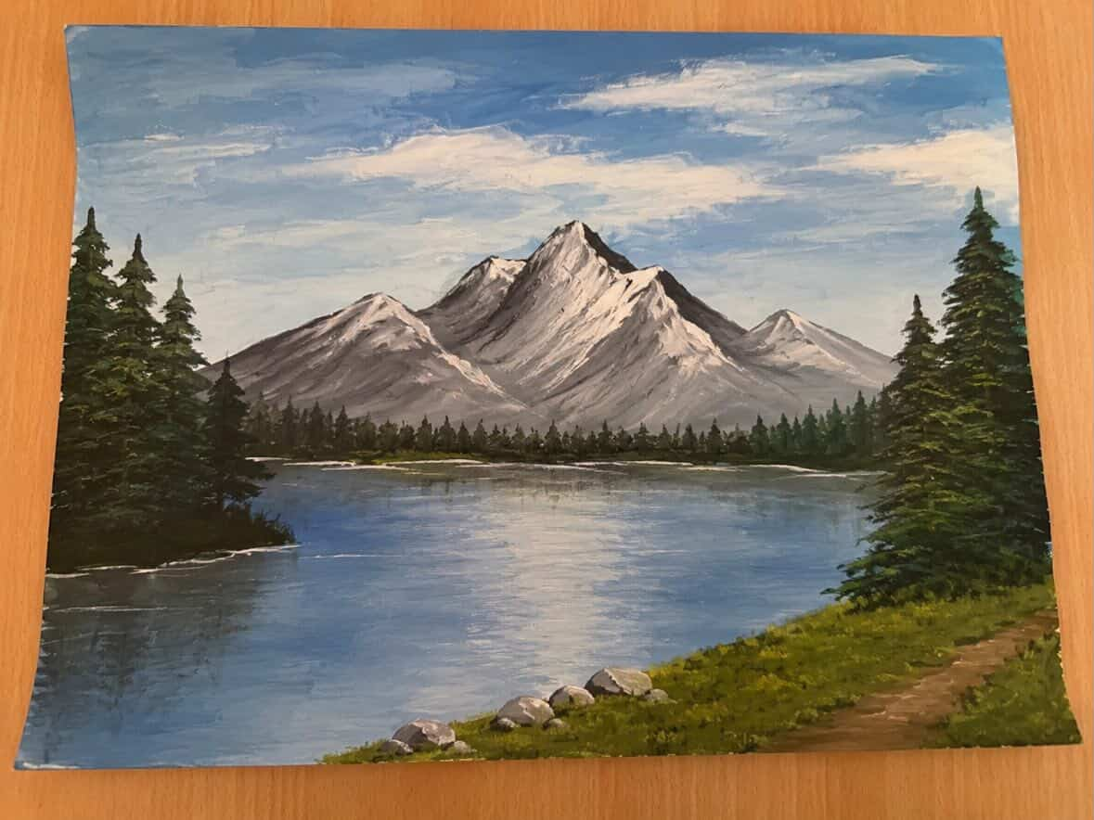


10. reflection

Slide 13
reference:
https://www.google.com/url?sa=t&source=web&rct=j&url=https%3A%2F%2Fdadslife.at%2Fgeschenke%2Fwasserfarbe%2F&ved=0CBcQjRxqFwoTCJjOuJfZxZQDFQAAAAAdAAAAABAF&opi=89978449
https://www.google.com/url?sa=t&source=web&rct=j&url=https%3A%2F%2Fde.dreamstime.com%2Fsommertagesalpines-dorf-den-bergen-formulieren-die-kunstillustration-landschaft-mit-aquarellen-gemalt-image209968321&ved=0CBcQjRxqFwoTCIj5gYvaxZQDFQAAAAAdAAAAABAF
https://www.google.com/url?sa=t&source=web&rct=j&url=https%3A%2F%2Fwww.kleinanzeigen.de%2Fs-wassermalfarben%2Fk0&ved=0CBcQjRxqFwoTCJjOuJfZxZQDFQAAAAAdAAAAABAr&opi=89978449
https://www.google.com/url?sa=t&source=web&rct=j&url=https%3A%2F%2Fwww.cipra.org%2Fde%2Fdossiers%2Fnatur-und-mensch%2Flandschaft&ved=0CBcQjRxqFwoTCNiHlenZxZQDFQAAAAAdAAAAABAF&opi=89978449
https://8-schule-leipzig.de/wp-content/uploads/2021/11/Logo_Grundschule_Haende_Kreis_resized-768x763.jpg
https://media.istockphoto.com/id/1267200399/de/vektor/uhrvektorsymbol-isoliert-auf-wei%C3%9Fem-hintergrund-gliederung-d%C3%BCnne-linie-uhr-symbol-f%C3%BCr.jpg?s=612x612&w=0&k=20&c=0aLXsNYI36H00rKMS0WVPjBET1fj_X1z6iIS3oUktR4
https://www.spielheld.de/out/pictures/generated/product/3/800_600_80/fineart-faecherpinsel-inkacolor-set-zeichnen.jpg
https://i.ytimg.com/vi/2IVNZUjr7-4/hq720.jpg?sqp=-oaymwEhCK4FEIIDSFryq4qpAxMIARUAAAAAGAElAADIQj0AgKJD&rs=AOn4CLDvoT_03DPiZaIKS93eTn_wtU9n4g
https://static.spektrum.de/fm/912/f2000x857/AdobeStock_52372438.jpeg
https://www.borkenerzeitung.de/Bilder/Statt-Unterricht-im-Klassenzimmer-lernen-viele-Kinder-998423.jpg
https://static.vecteezy.com/system/resources/previews/032/461/353/non_2x/home-icon-for-dwelling-and-residence-vector.jpg
https://www.ikea.com/de/de/images/products/relatera-schreibtisch-weiss__1355171_pe952947_s5.jpg?f=s
https://magazin.sofatutor.com/schueler/wp-content/uploads/sites/4/2021/03/shutterstock_1178415421.jpg
https://www.superprof.de/blog/wp-content/uploads/2019/07/pinsel-stifte-malen-palette.jpg
https://asc-images.forward-publishing.io/2021/5/8/4ce7fdf0-553c-44c9-9ff7-0a54318511c7.jpeg?w=1200&auto=compress%2Cformat
https://img.freepik.com/vektoren-premium/schueler-mit-klassenkameraden-in-der-klasse_28629-3044.jpg
https://www.cornelsen.de/_Resources/Persistent/c/2/0/9/c20936499ef4a7812a4b1beb82b93bef49aab5a8/migration-magazin-1140x760.jpg
https://as1.ftcdn.net/jpg/02/65/69/64/1000_F_265696476_RJPxKOsG8aBpFvqfRPK8WFvT8L3hbTJt.jpg
https://encrypted-tbn0.gstatic.com/images?q=tbn:ANd9GcR8N9GTfbOSDCgC_hfWjNbapnn00cxiM_mT9w&s
https://s.alicdn.com/@sc04/kf/H49f003af7f3a486e92f643af9ccc1e59h.jpg
https://cdn.supercoloring.com/worksheet/2117975/drawing-landscape-easy-step-by-step-puzzle-games-wm.png
https://shop.strato.de/WebRoot/Store9/Shops/78310611/5515/1C3F/0930/8CA6/F09E/C0A8/2ABB/B45B/prozess_400.jpg
https://encrypted-tbn0.gstatic.com/images?q=tbn:ANd9GcT9XmOCH-Xk6ryx7vj8qaI-JF2VbYt_IsDrPg&s
https://encrypted-tbn2.gstatic.com/shopping?q=tbn:ANd9GcSRhHHww05WOYOurQ0L-5Sqz6EHxAZSu9FBbmtuYRWkISRsovLLrletxGNp274lg96bX2Q89ObECDlk1bVINAwrFqLkDmibM5R0mWyBGY0&usqp=CAc
https://image.brigitte.de/12213288/t/XG/v4/w1440/r0/-/naturwunder-elbsandsteingebirge.jpg
https://ninapaints.de/wp-content/uploads/2020/10/Baeume-3-e1603738104543-768x768.jpg
https://i.ytimg.com/vi/Afgh9KQzp48/sddefault.jpg
https://jenflorentine.com/cdn/shop/files/River-Way-Painting.jpg?v=1756221260&width=1946
https://www.artistsnetwork.com/wp-content/uploads/2016/01/chalk-pastel-techniques_Elizabeth-Mowry-2.jpg
https://static.vecteezy.com/system/resources/previews/004/180/849/non_2x/painting-with-parent-black-glyph-icon-develop-kid-skills-exercising-creativity-encourage-artistic-child-art-therapy-silhouette-symbol-on-white-space-isolated-illustration-vector.jpg
https://previews.123rf.com/images/tannjuska/tannjuska1303/tannjuska130300085/18364397-artist%E2%80%99s-hand-with-paintbrush-painting-the-picture.jpg
https://www.wikommverlag.de/wp-content/uploads/pexels-andrea-piacquadio-933255.jpg
https://cdn.shopify.com/s/files/1/2737/5344/files/Farben_mischen_480x480.png?v=1625138570
https://thumbs.dreamstime.com/b/unprofessioneller-maler-denkt-%C3%BCber-reparaturprobleme-bauarbeiter-nicht-der-lage-mauern-zu-malen-mit-malerpinsel-probleme-392738100.jpg
https://static.simplify.de/wp-content/uploads/2021/09/134-Freude-gluecklich-824x434.jpg
https://www.meinherzsagtkunst.de/wp-content/uploads/2024/05/malen-wasserfarben.jpg
https://previews.123rf.com/images/artcuboy/artcuboy2302/artcuboy230200700/199115934-an-illustration-bursting-with-vibrant-creativity-ideas-and-imagination-a-dynamic-and-inspiring.jpg

